Slide 1

SMPC for Decentralized Distributed Systems
Frederic Klein – Final Talk

Slide 2
Gamification

Slide 3
Gamification
Generate intrinsic motivation
Among other motivators:
competition
social comparison

Slide 4
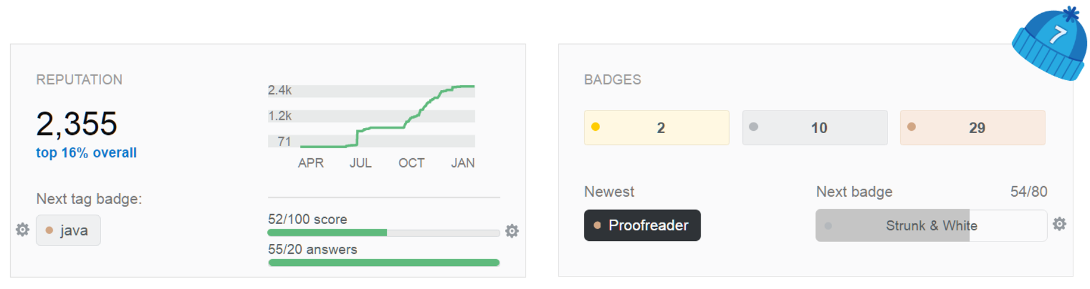
Gamification
Examples
Stackoverflow, Amazon, runtastic, etc.

Slide 5
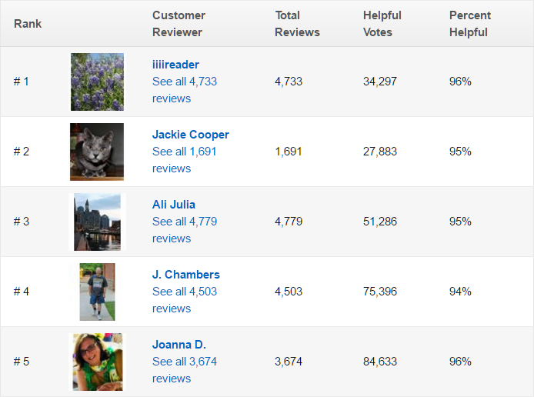

Gamification
Examples
Stackoverflow, Amazon, runtastic, etc.

Slide 6

The Hygiene Games
Example: Hygiene Games
Gamification approach for hand-hygiene compliance
Targeting health-care professionals
Sensors, personal smartphone
Notes:
HAIS: 4.1 million infections per year in the EU, a quarter preventable

Slide 7
Privacy Concerns
Sensitive data
Medical information, financial data, work performance
Sharing might result in disadvantage
Liability, negotiations, shamification
Notes:
Examples: employees don’t want to be tracked to detailed

Slide 8
Requirements
Social
High privacy demands
Feasible algorithms for acceptance
Unobtrussive

Slide 9
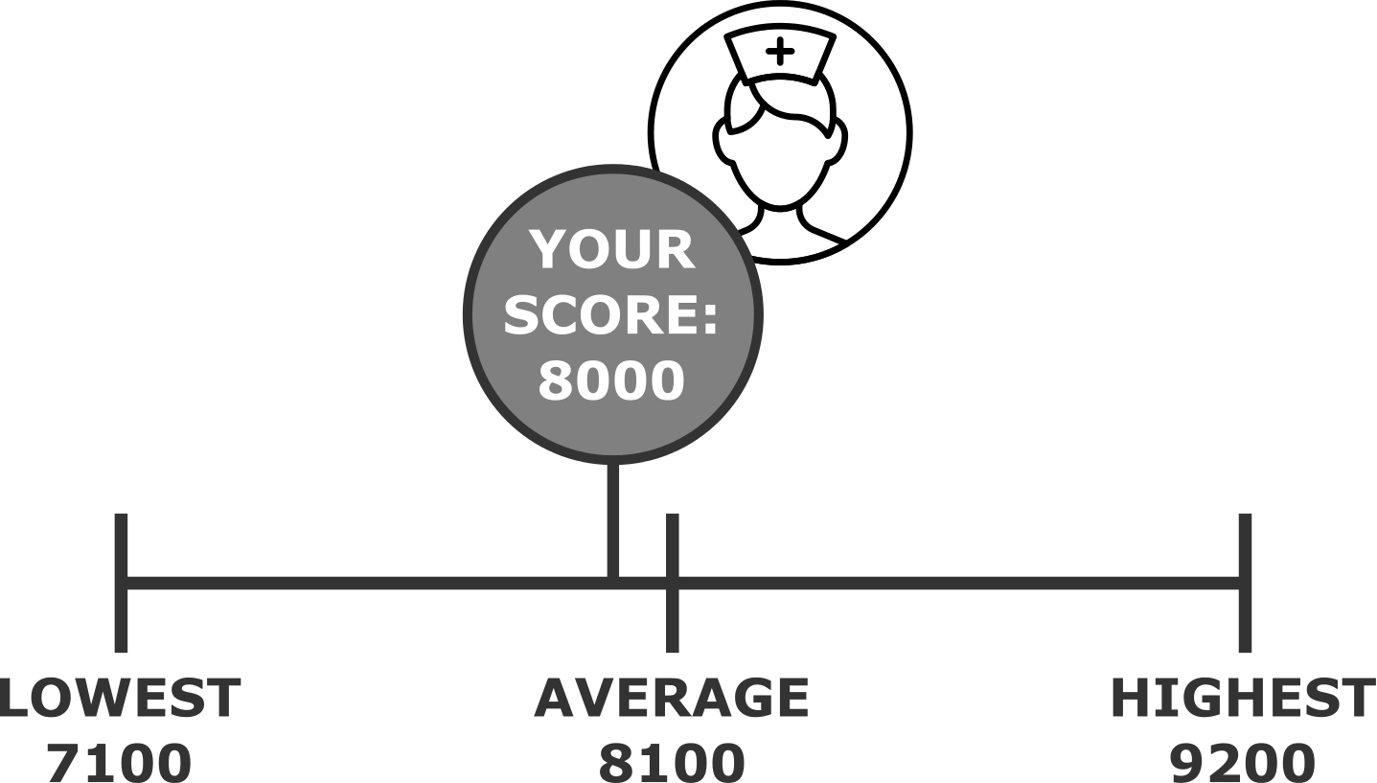
Requirements
Technical
System-wide statistics
Independent from Internet access
Infrastructure-less, self-forming network
Notes:
EMI
Simple integration and low maintenance

Slide 10
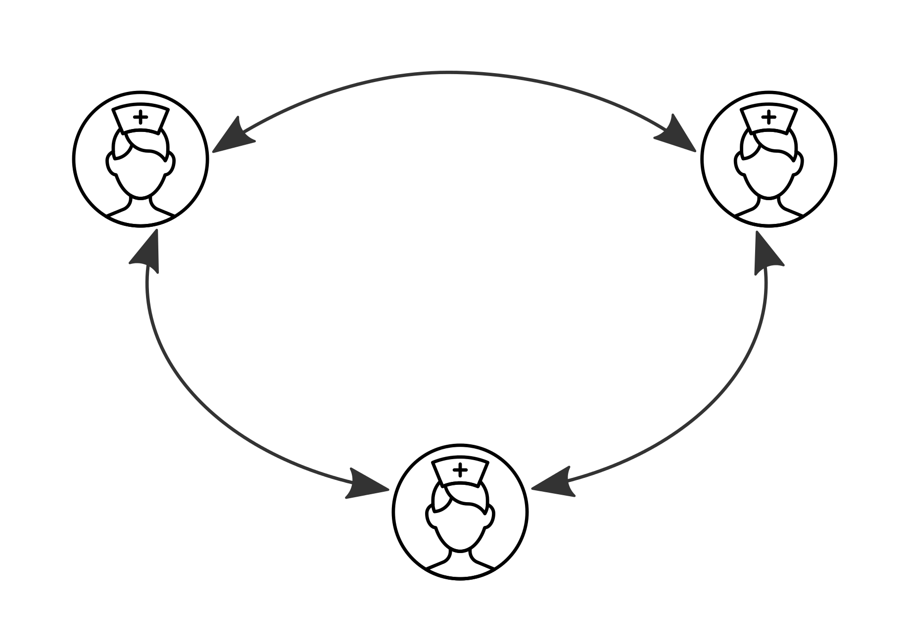
Design
Notes:
Communication channel

Slide 11
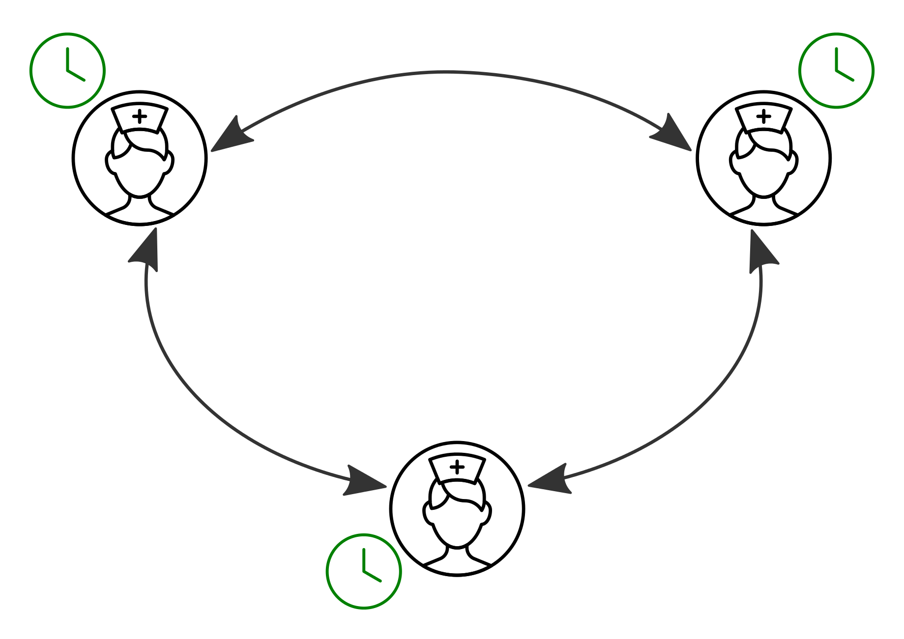
Design
Notes:
Clock synchronization

Slide 12
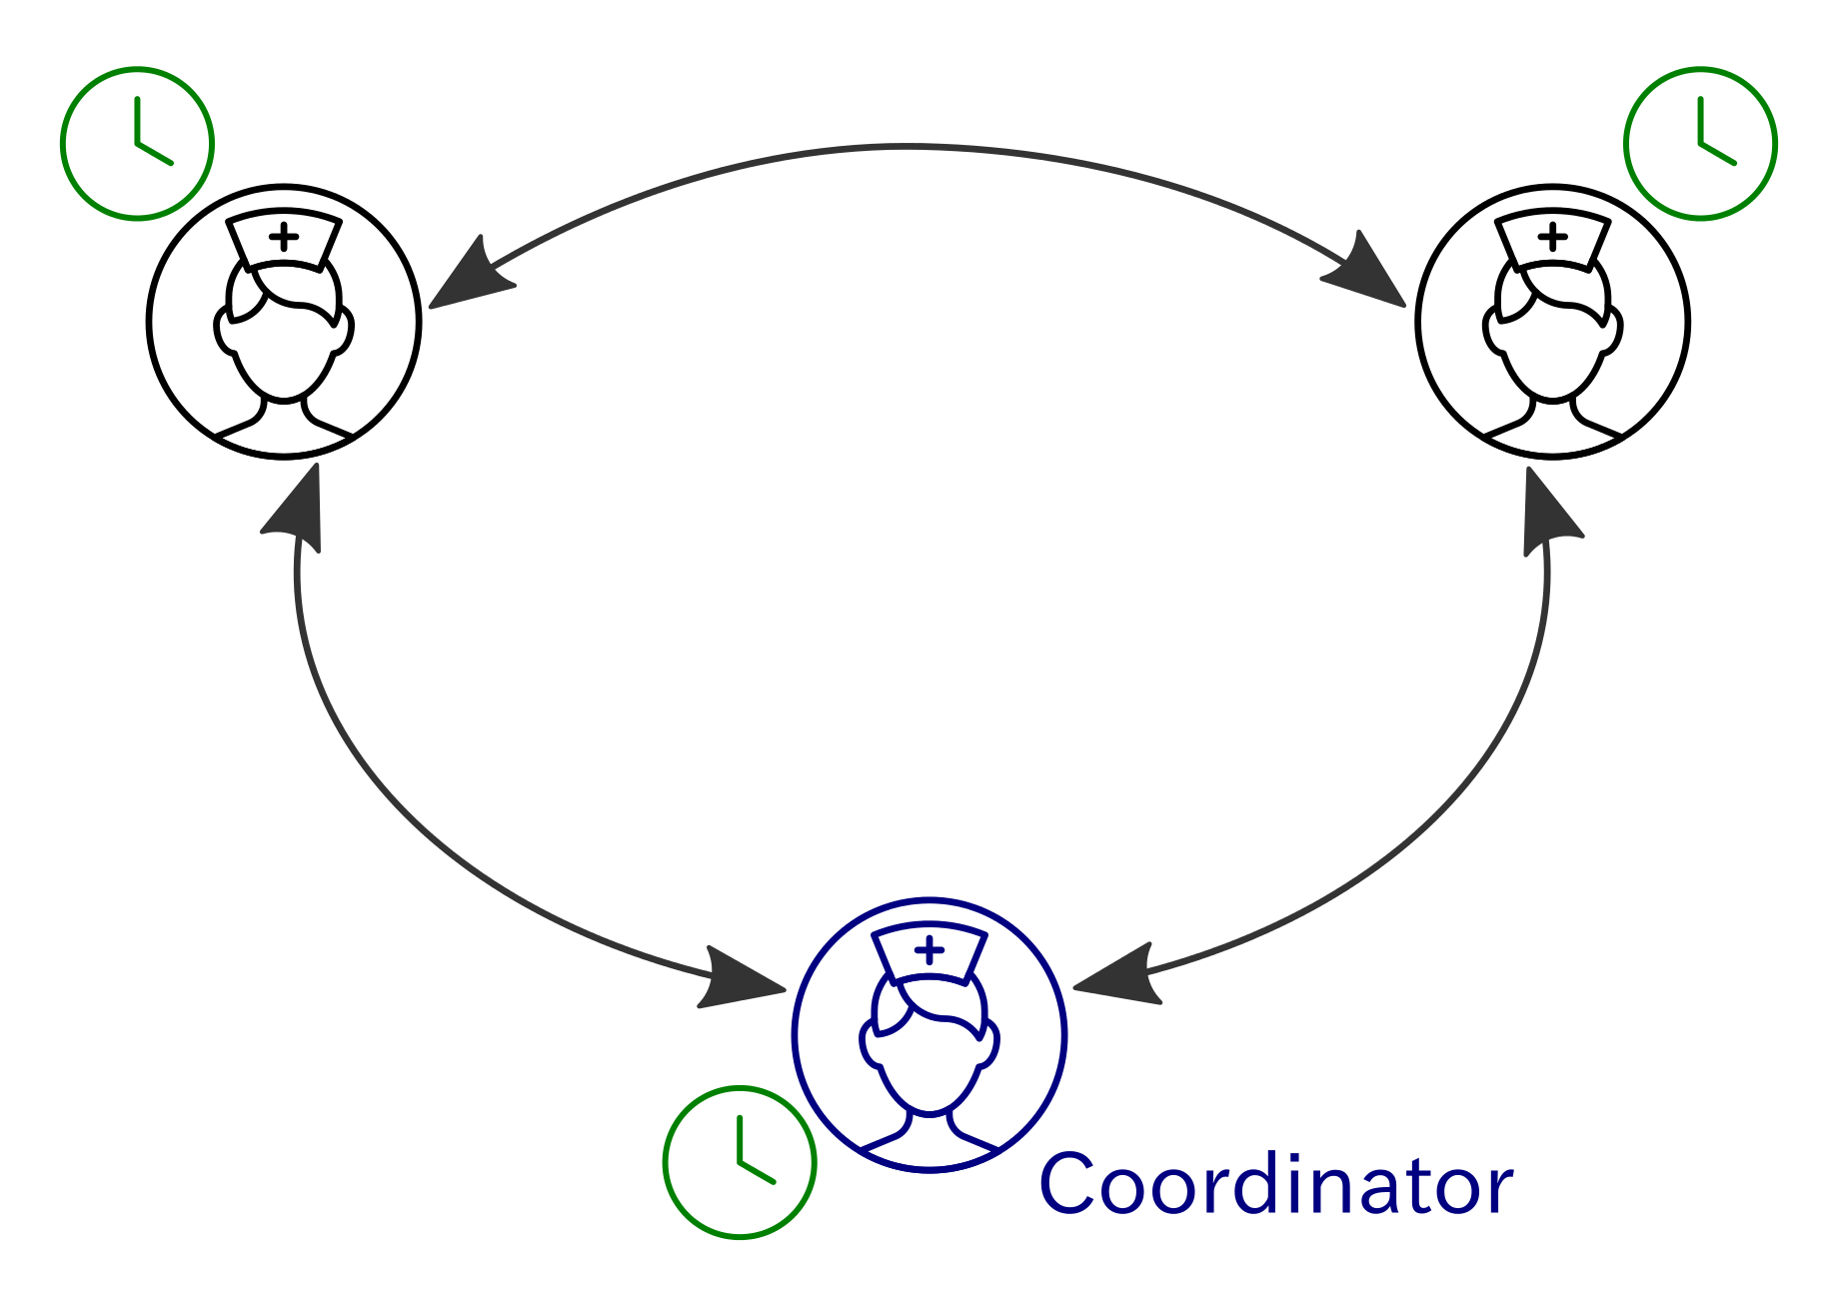
Design
Notes:
Coordinator election

Slide 13
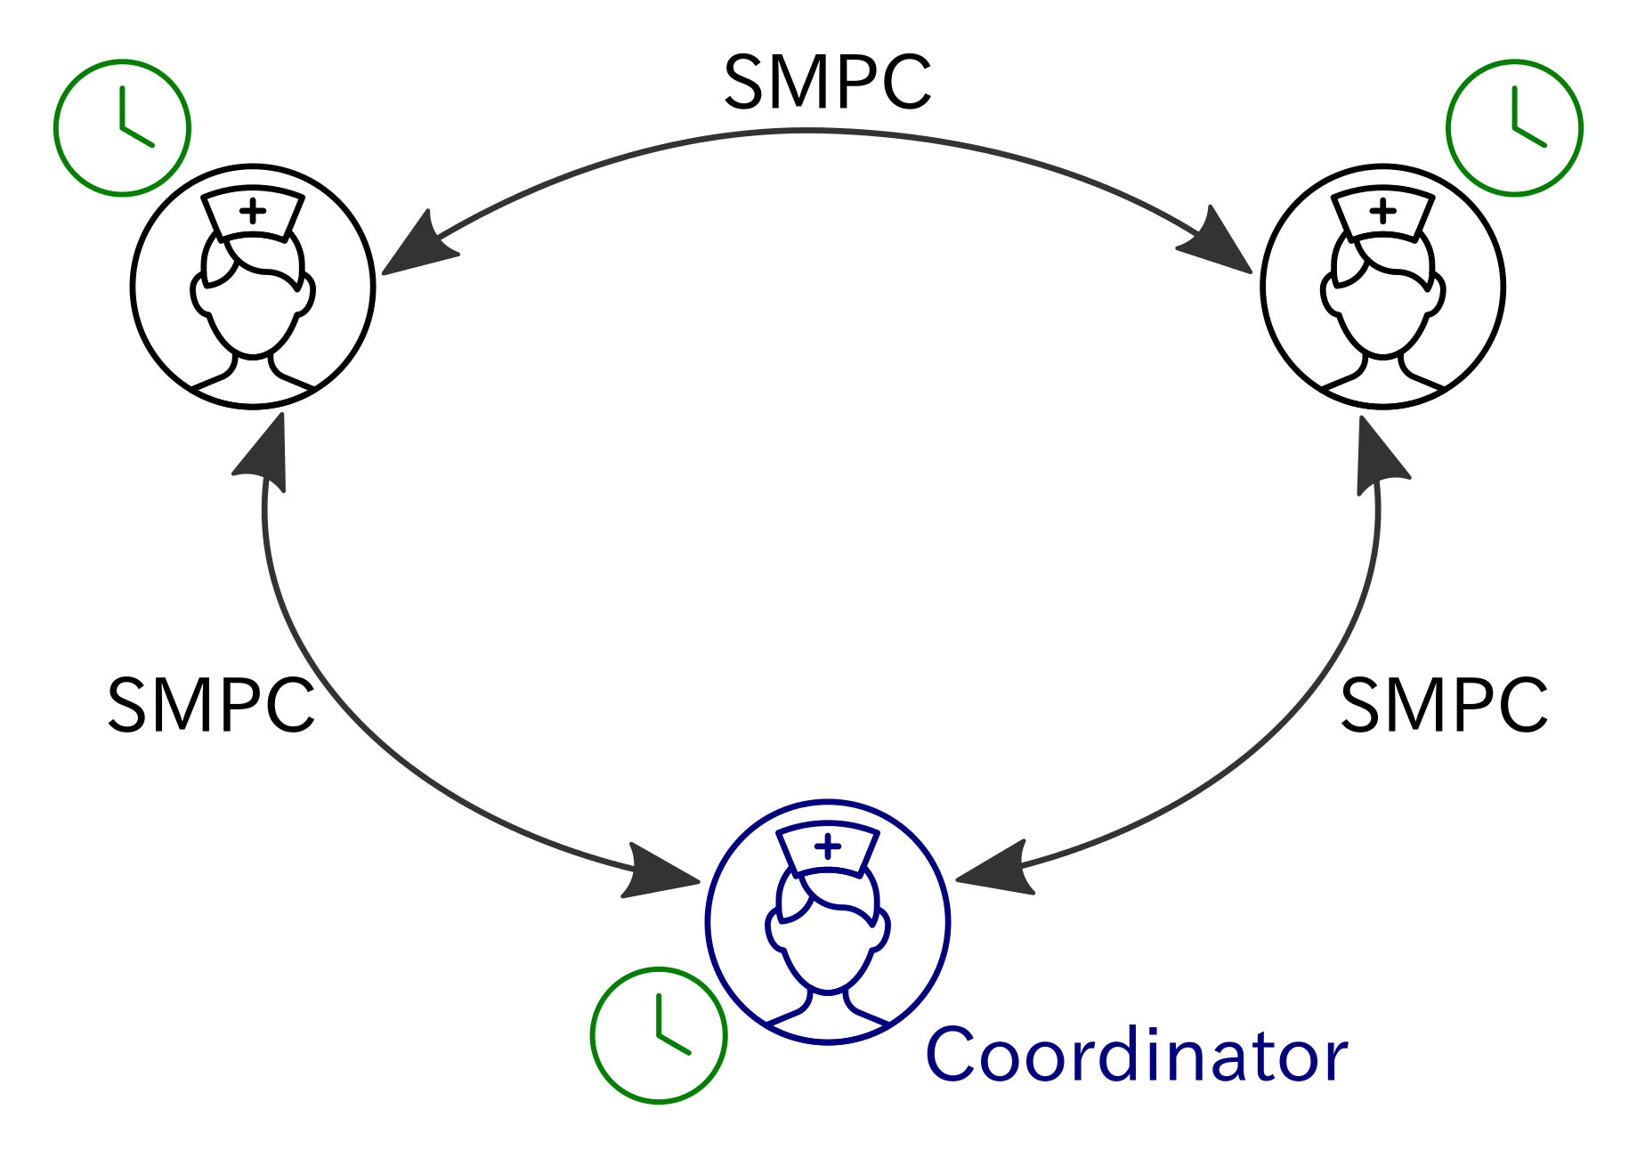
Design
Notes:
SMPC computation

Slide 14
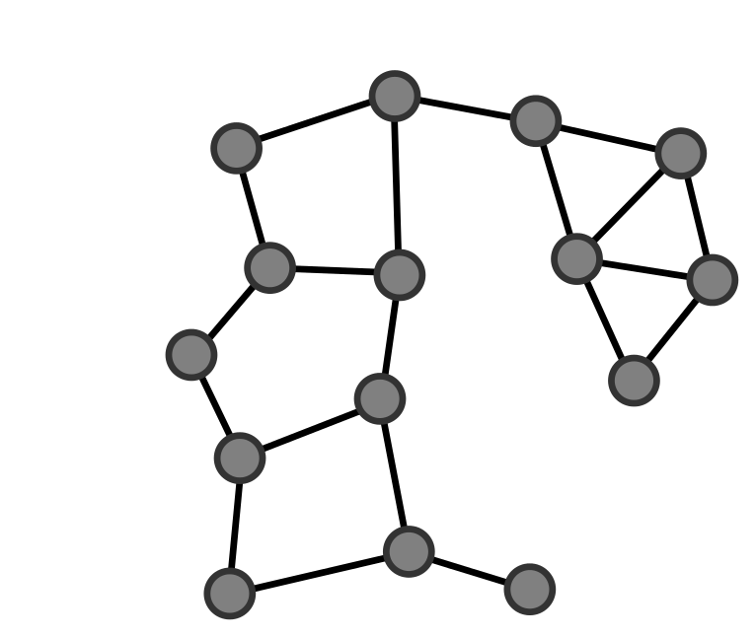
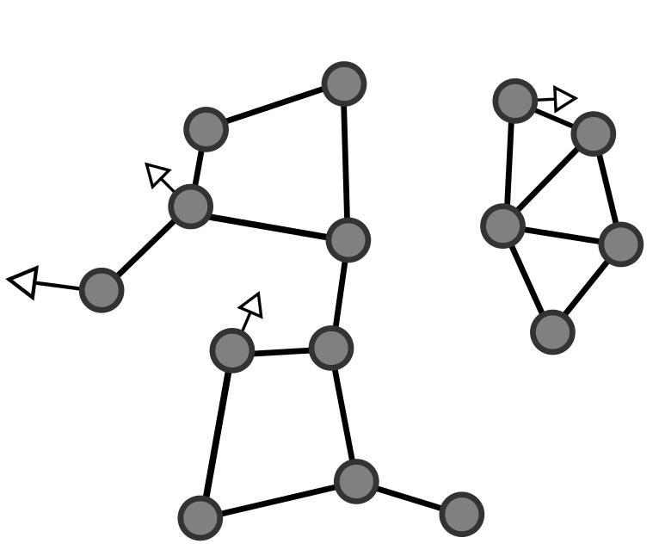
Design: MANETs
MANET/SPAN
Mesh networks with moving nodes
Infrastructure-less
self-forming
self-healing

Slide 15
Design: MANETs
MANET/SPAN on Android
Not included in API
Abilities of Bluetooth modules vary
Sequential communication
Pairing-less connection
Insecure RFCOMM
Encryption layer

Slide 16
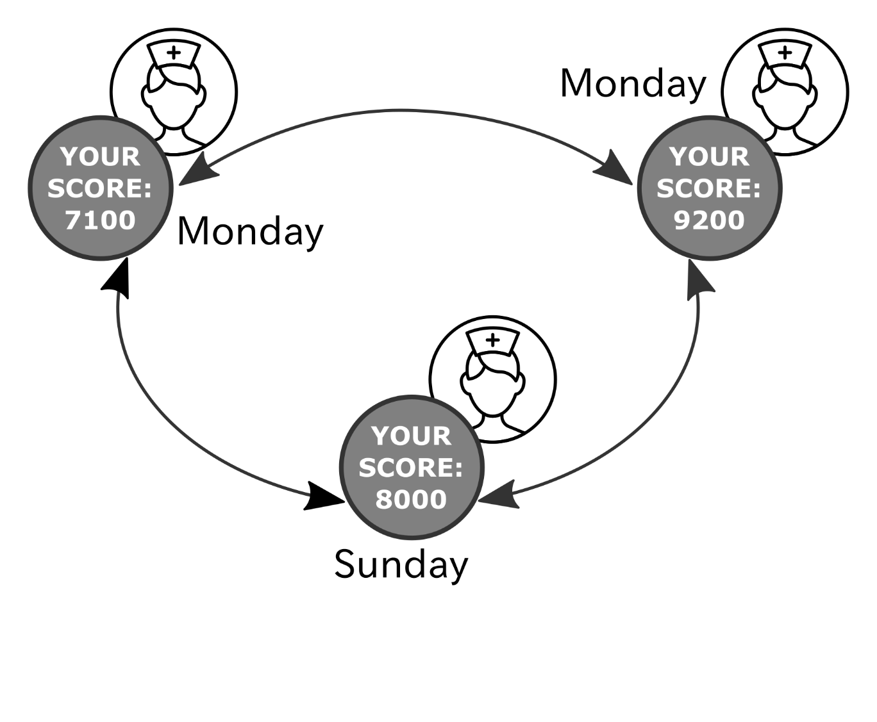
Design: Clock Synchronization

Slide 17
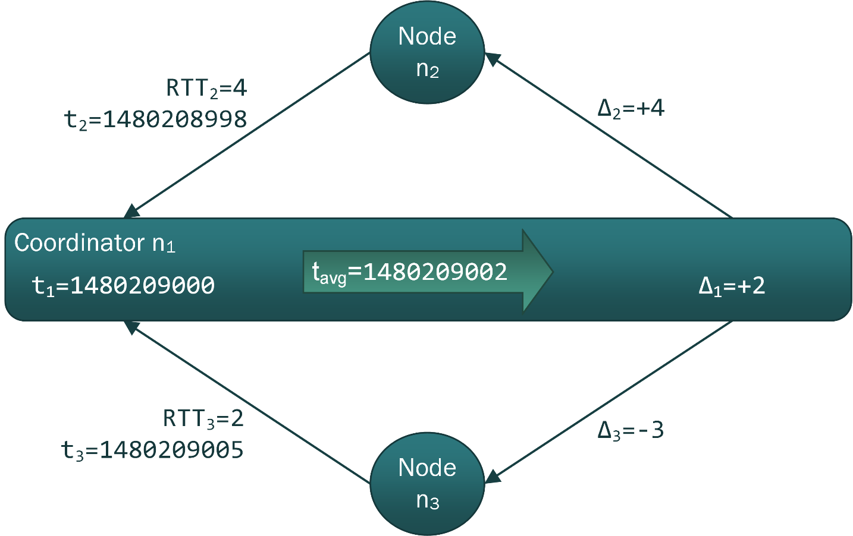
Design: Clock Synchronization
Internal synchronization of clocks
Berkeley Algorithm

Slide 18
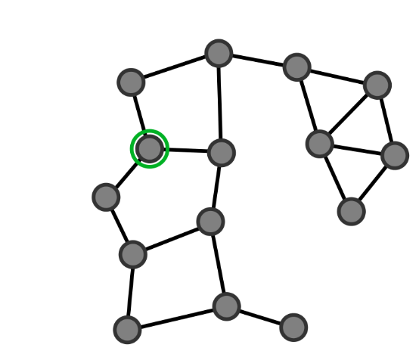
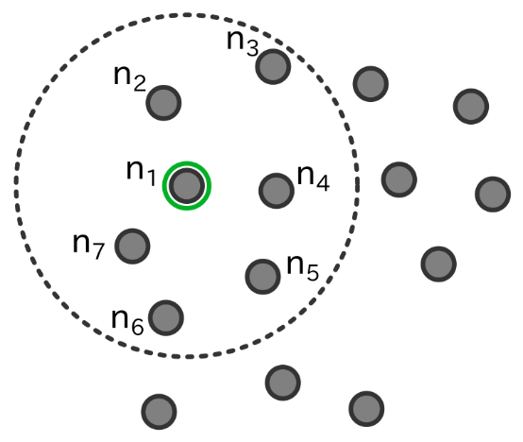
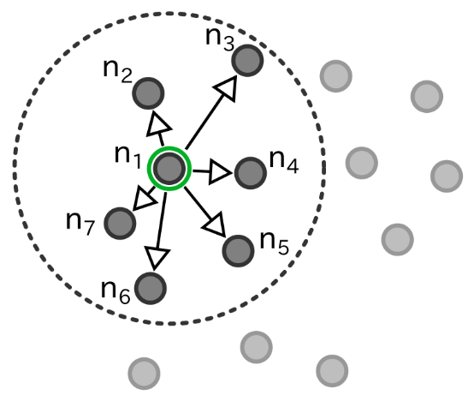
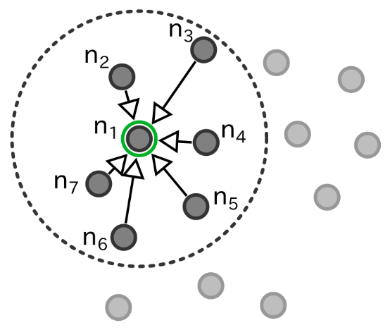
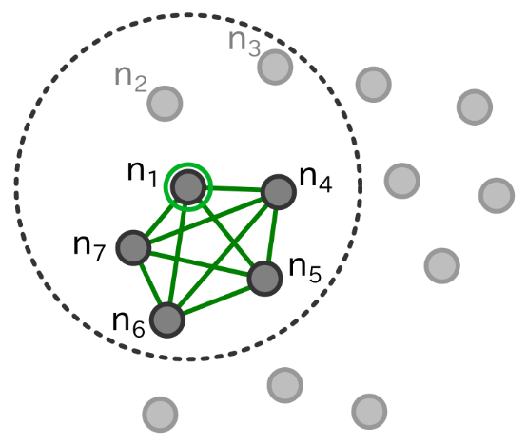
Design: SMPC
Coordinator election
Event driven
Timer based
Notes:
In a mesh/MANET: secure multi-hop routing;
Android: missing -> Formation of fully meshed sub network for SMPC

Slide 19
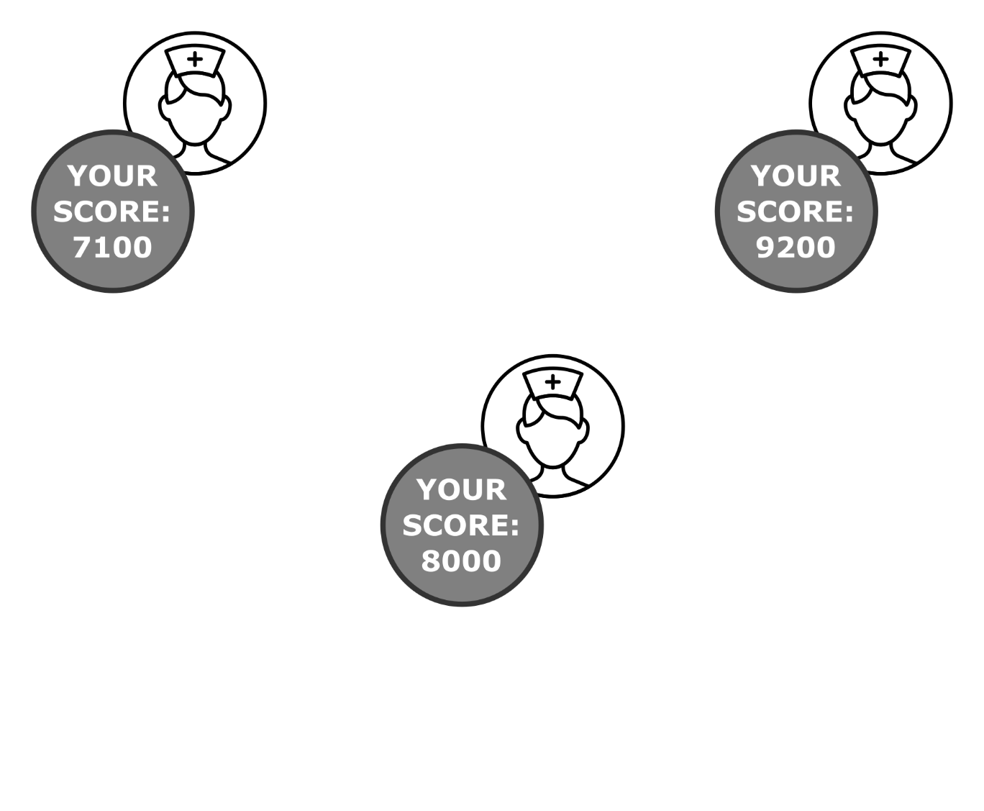
Design: Privacy Protection
Personal data on own device
Modest value without comparison
Notes:
Gamification: key issue is comparison -> motivation

Slide 20

Design: Privacy Protection
Exchange data for comparison
Notes:
Therefore privacy protecting exchange of data is needed so that …

Slide 21
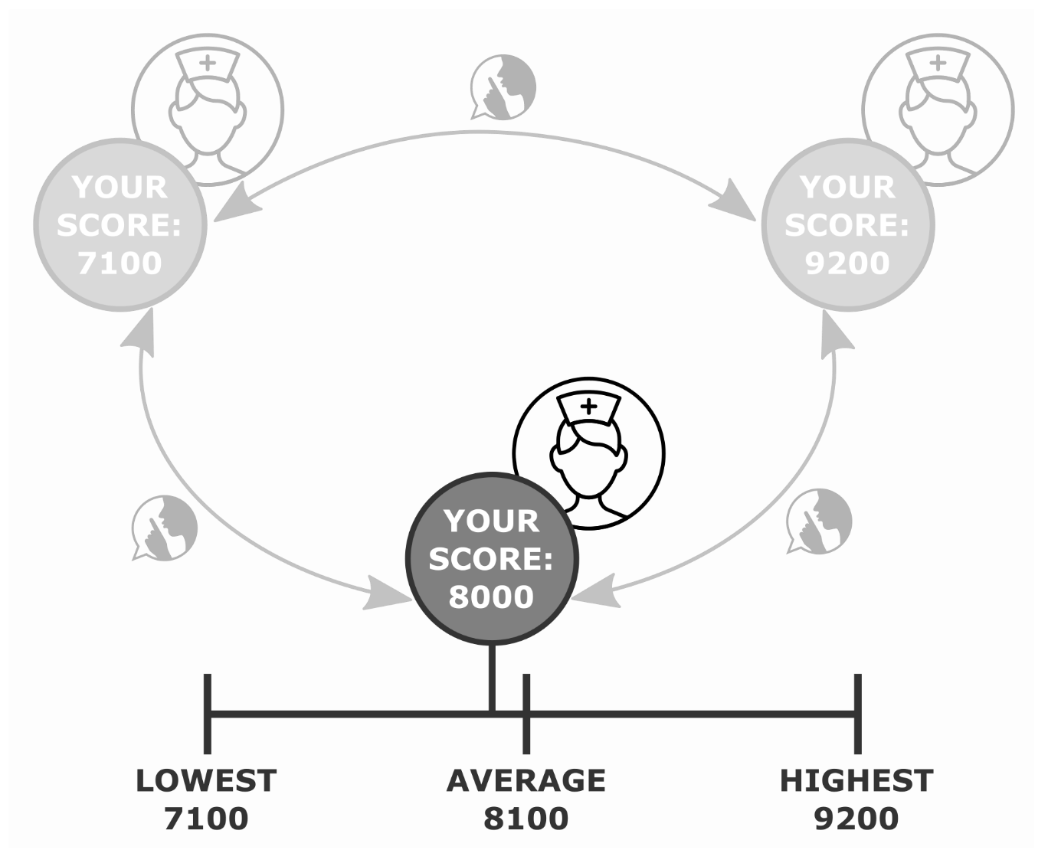
Design: Privacy Protection
Statistical data reflecting system wide performance for comparison
Notes:
While data exchange and privacy seem to be contradictory,
Solution to maintain privacy while doing computation on data from multiple parties is SMPC

Slide 22
Design: SMPC
Subfield of cryptography:
compute function over inputs of multiple parties
keep the inputs private

Slide 23
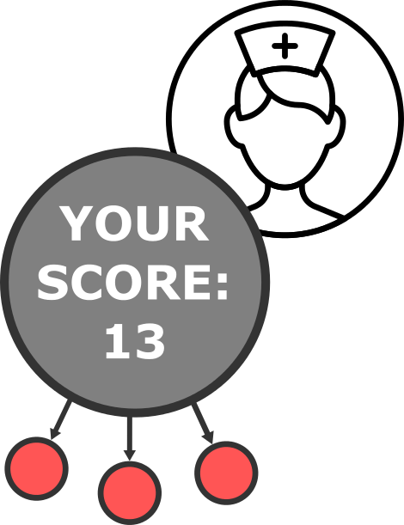
Design: SMPC algorithms
Based on Shamir’s secret sharing
Defines function for shares
Lagrange interpolation for recombination
Notes:
Basic knowledge math
Modular arithmetic (ring)

Slide 24
Design: SMPC algorithms
Secure Sum
Sum over secrets equals Lagrange interpolation over sum of shares

Slide 25

Design: SMPC algorithms
Three parties
Score as input
Notes:
Returning to the initial example…

Slide 26
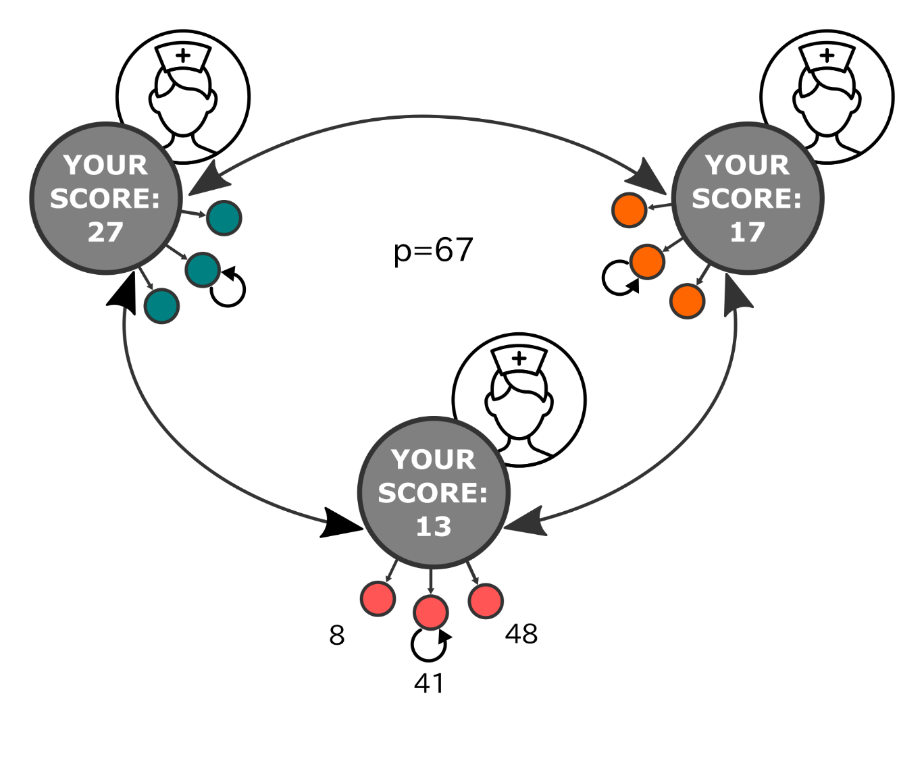
Design: SMPC algorithms
Secret sharing: n shares for n parties
Notes:
Instead of sharing their score (also called secret)…
Standalone share is nearly irrelevant.

Slide 27
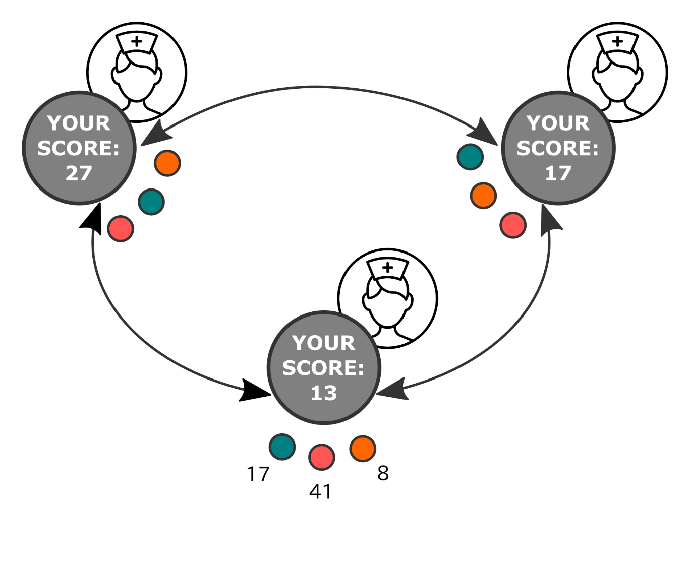
Design: SMPC algorithms
Each player: set of n shares

Slide 28
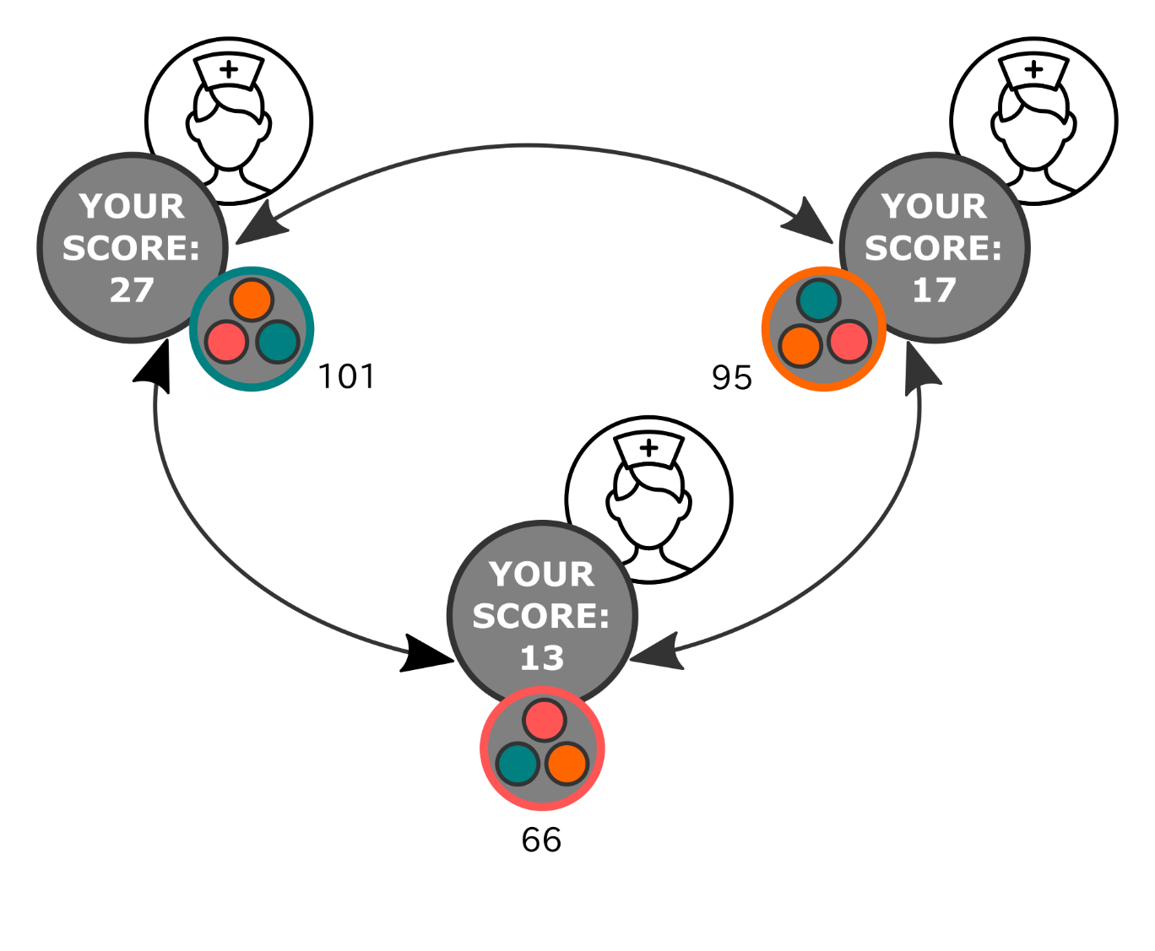
Design: SMPC algorithms
Computation on shares
Broadcasting of result
Notes:
Computation on shares (for example sum them up)

Slide 29
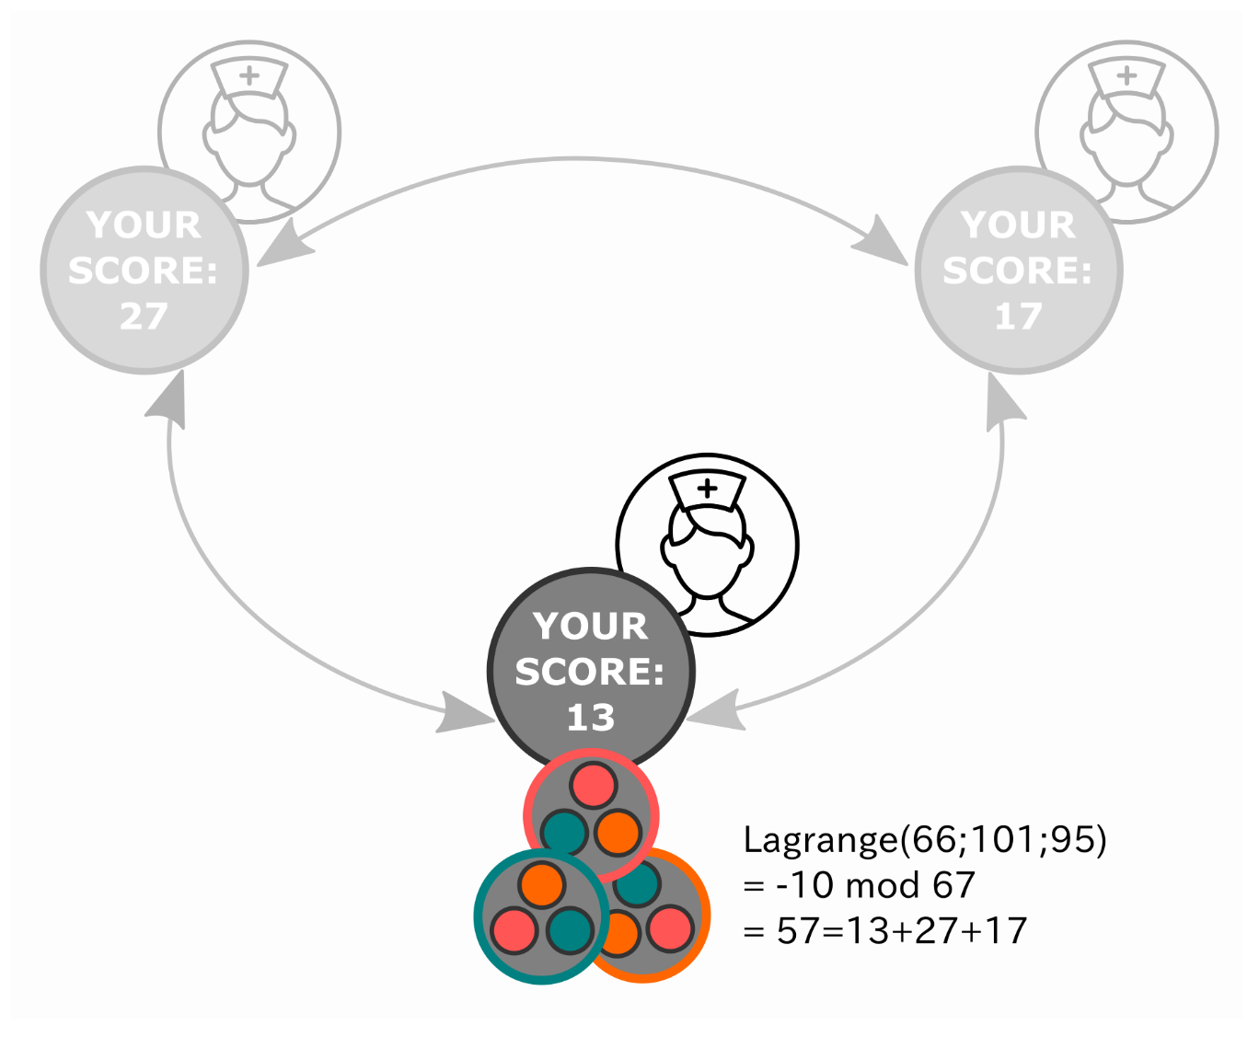
Design: SMPC algorithms
Each party:
Complete information
Other inputs: remain secret

Slide 30
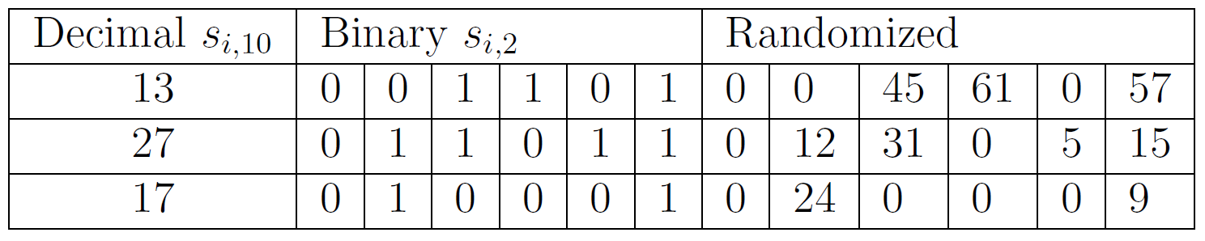
Design: SMPC algorithms
Secure Maximum
Bit decomposition
Secure sum for each bit position from MSB
Self disqualification
0 1
Notes:
In table: secrets, not shares!

Slide 31
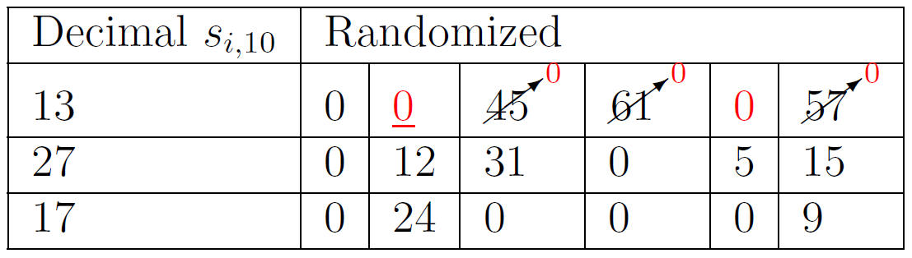
Design: SMPC algorithms
Secure Maximum
Bit decomposition
Secure sum for each bit position from MSB
Self disqualification
0 1 1

Slide 32
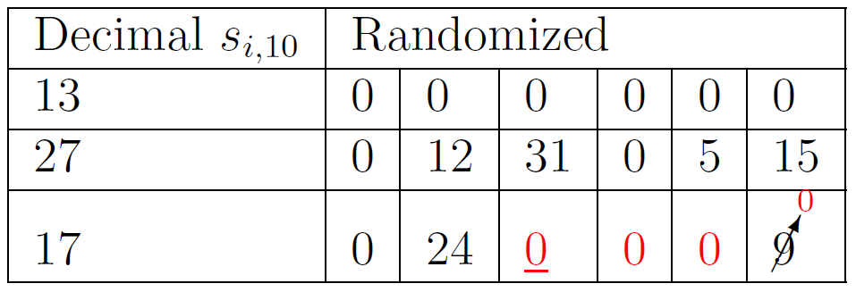
Design: SMPC algorithms
Secure Maximum
Bit decomposition
Secure sum for each bit position from MSB
Self disqualification
0 1 1 0 1 1

Slide 33
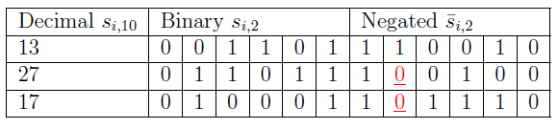
Design: SMPC algorithms
Secure Minimum
Bit decomposition
Inverting
Secure sum for each bit position from MSB
Self disqualification
Inverting result

Slide 34
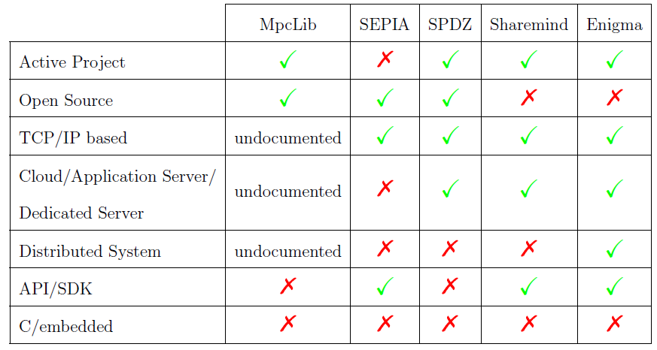
Existing Frameworks
Existing frameworks
Rely on the Internet
Powerful but complex

Slide 35
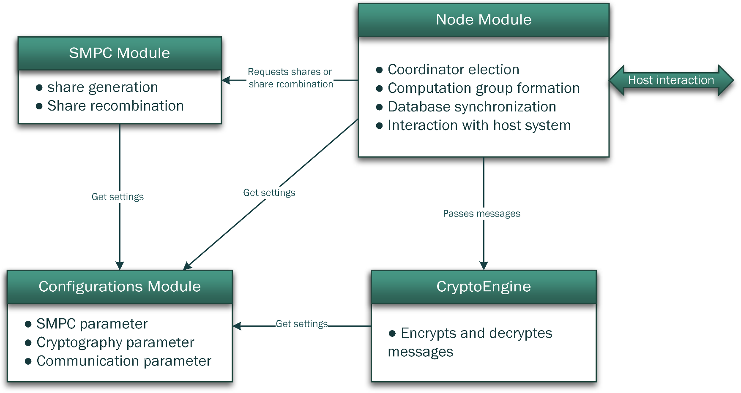
Implementation: framework
C library for compatibility
All parameters in Configuration
Interfacing: Node Module

Slide 36
Evaluation
Simulations
Android integration tests
Notes:
Applicable for real life situations?
Acceptable for users: power consumption? Interaction needed?
Simulations: based on core implementation: NODE, SMPC, CRYPTO LIBRARY WOLF CRYPT

Slide 37
Evaluation
Simulations
Number of computation group nodes
Reduced computation power
Notes:
Applicable for real life situations?
Acceptable for users: power consumption? Interaction needed?

Slide 38
Evaluation: Simulation
Linux script creating nodes
Adjustable number of nodes
Delayed named pipes to simulate wireless connection
Restriction of CPU through power management

Slide 39
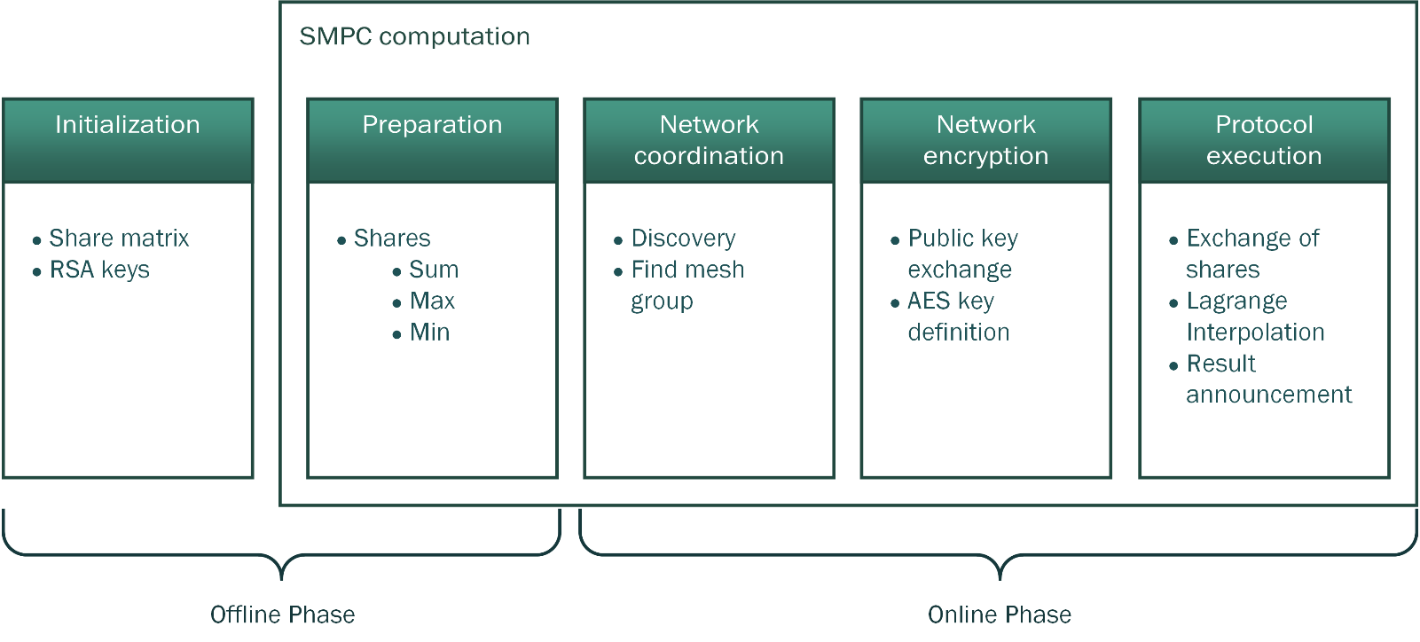
Evaluation: Simulation
Performance of online phase
Notes:
Script parameter

Slide 40
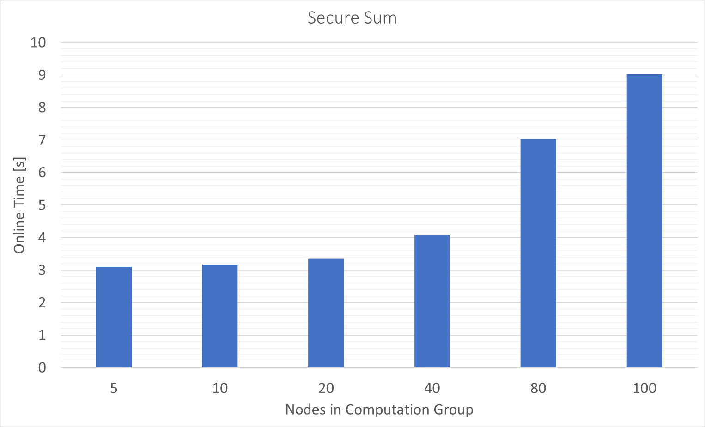
Evaluation: Simulation Results
Discovery: bottle neck
Computation: fast enough
Notes:
Influence of number of nodes in computation group

Slide 41
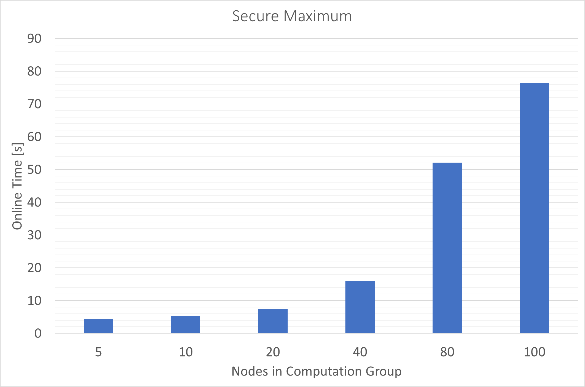
Evaluation: Simulation Results
Number of messages squared
Larger groups: network partition

Slide 42
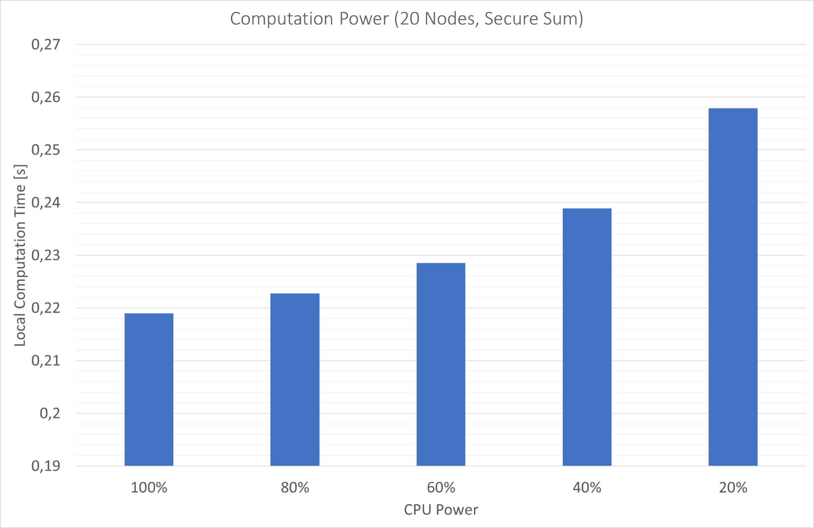
Evaluation: Simulation Results
Influence low compared to message overhead
Notes:
Influence of computation power low compared to message overhead

Slide 43
Evaluation : Android Integration
Android integration tests
Power consumption
NDK/JNI wrapper tests
Notes:
Acceptable for users: power consumption? Interaction needed?

Slide 44
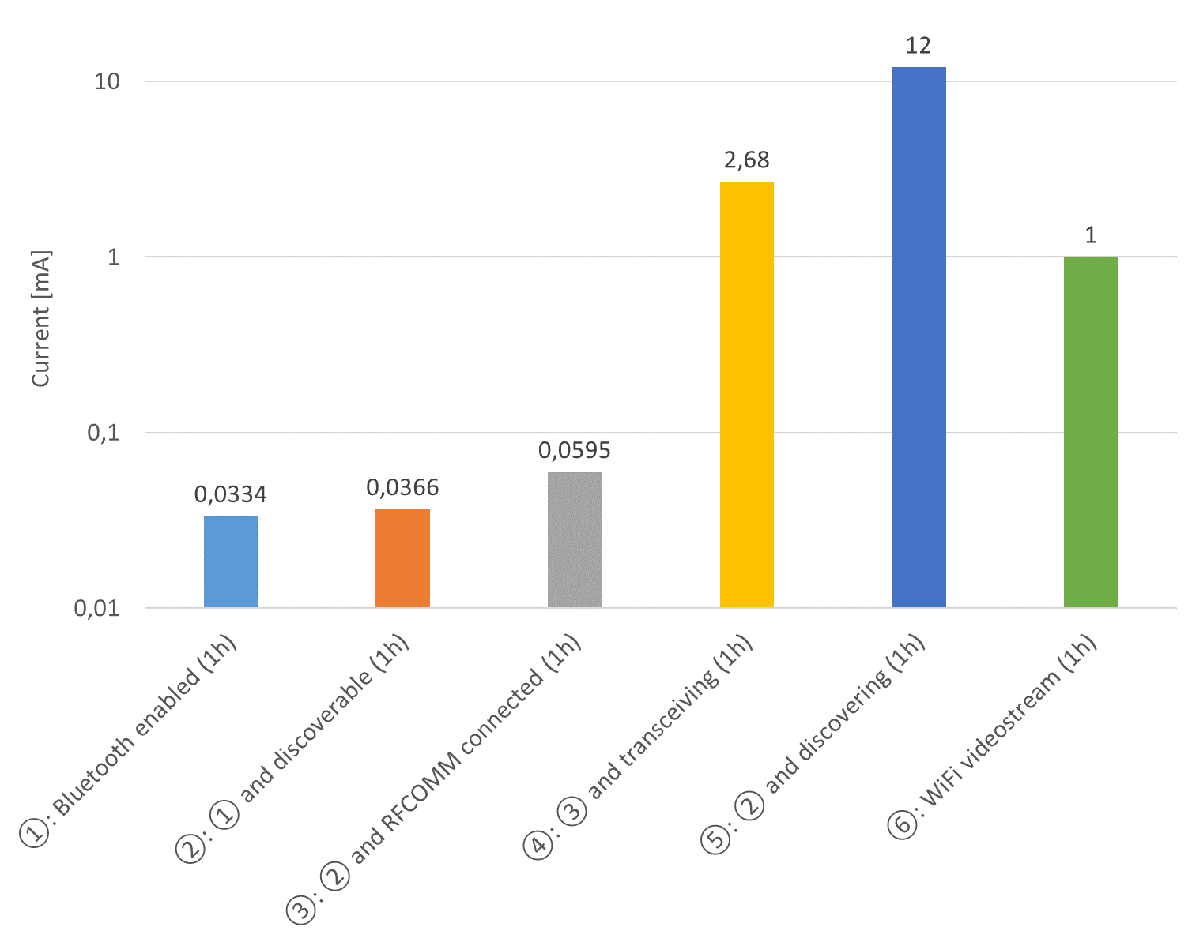
Evaluation: Android Results
Power consumption (logarithmic scale)
Notes:
Measurements for 1 h

Slide 45
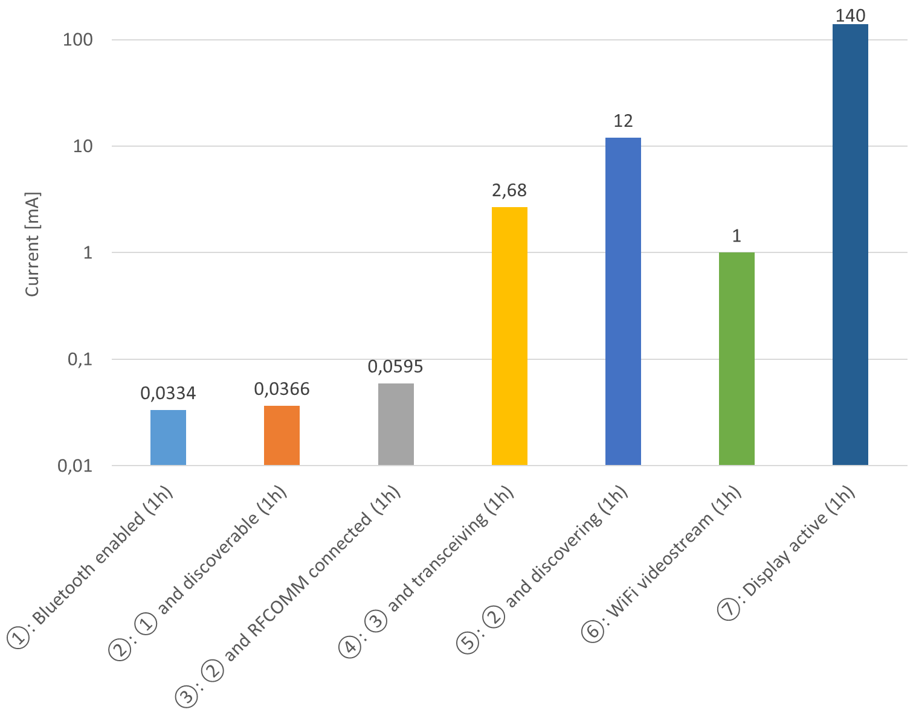
Evaluation: Android Results
Power consumption (logarithmic scale)
Notes:
Factor 10 higher

Slide 46
Evaluation: Android Integration
NDK/JNI wrapper
No API conflicts
Wolf Crypt accessible
Bluetooth communication
Variations in discovery behavior
Notes:
Android 4.0.3 upwards tested -> 99% market share

Slide 47
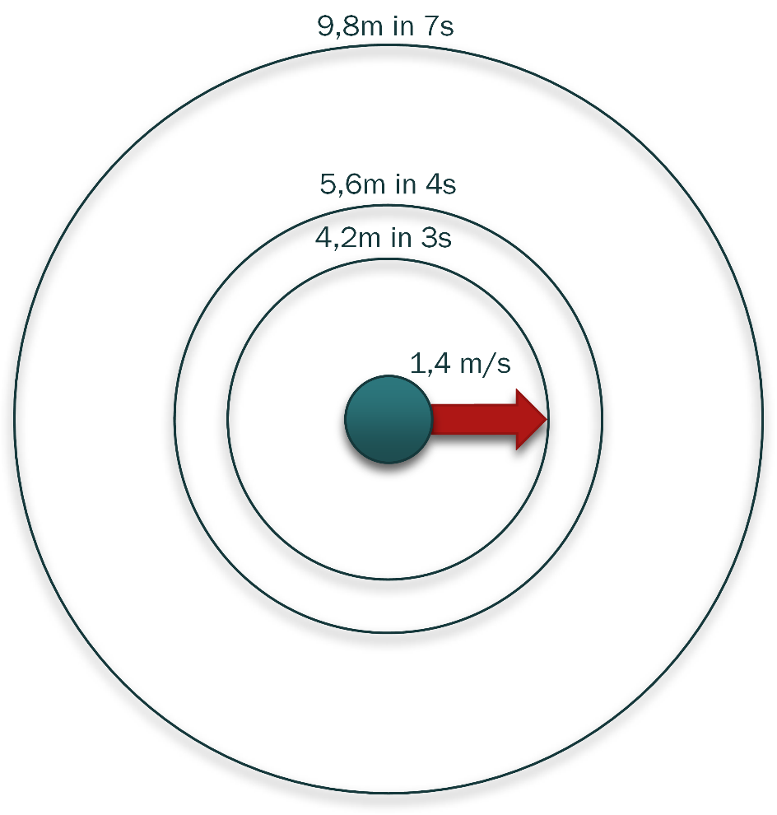
Discussion
up to 20 nodes time frame acceptable

Slide 48
Conclusion
Selected algorithms fit for real life settings
Feasible for interdisciplinary users
Suited for embedded/wearable devices
Integration in Android through NDK
Unobtrusive (power/usage)

Slide 49
Outlook
Prepare for open source
Hygiene Games integration
BLE advertisement instead of Bluetooth Classic discovery
Notes:
Write paper -> draw attention
Extension of simulation: tool for integration
Separate MANET features into standalone library

Slide 50


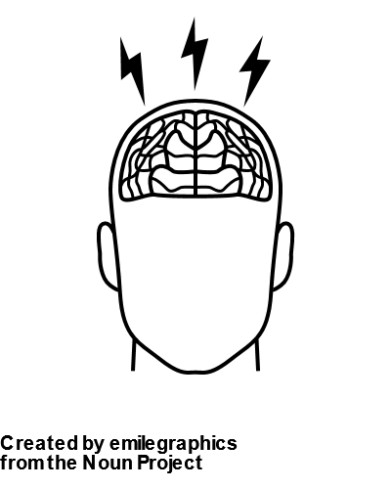



Icon References
Created by Martin Smith from the Noun Project
Created by emilegraphics from the Noun Project
Created by Mourad Mokrane from the Noun Project
Created by Danil Polshin from the Noun Project
Created by Bohdan Burmich from the Noun Project
Created by Alfa Design from the Noun Project
Notes:
Write paper -> draw attention
Extension of simulation: tool for integration

